Slide 1

How to decouple your code
Using mediatr to implement mediator design pattern

Slide 2
Agenda
Standard approach and it’s problems
Mediator design pattern
Pipelines

Slide 3
Code and extra materials
https://github.com/vesou/MediatRDemo
https://github.com/jbogard/MediatR/wiki
Code Opinion - Why to use MediatR
Jonathan Williams YT
Nick Chapsas YT

Slide 4
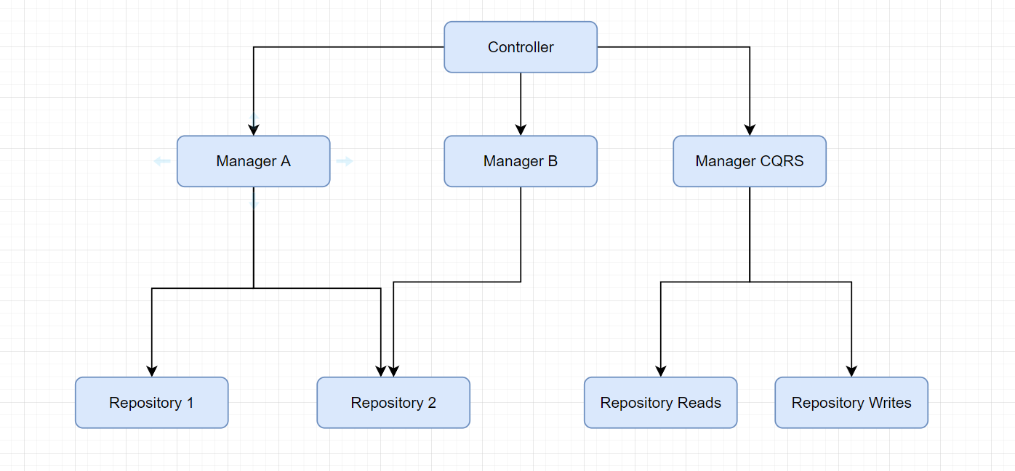
Standard approach

Slide 5
Problems with standard approach
Extending functionality – Open/Close Principle
Single Responsibility Principle
Interface Segregation Principle

Slide 6
Solution…

Slide 7
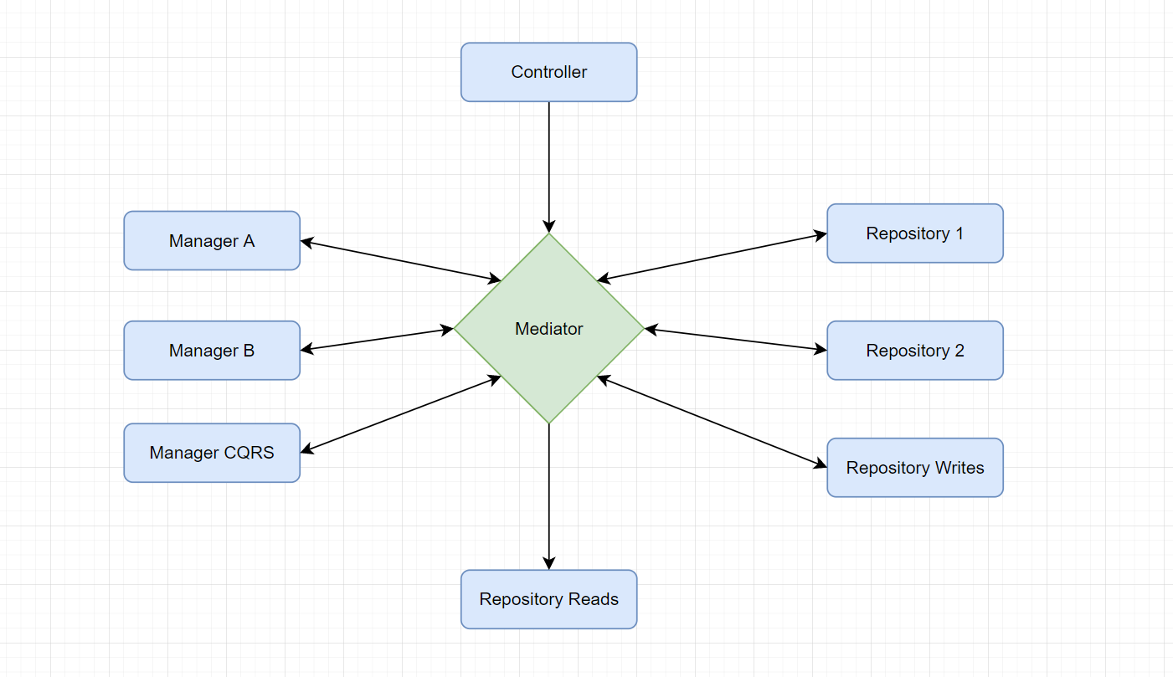
Mediator design pattern

Slide 8
Simple mediator implementation

Slide 9
Pipeline behaviour

Slide 10
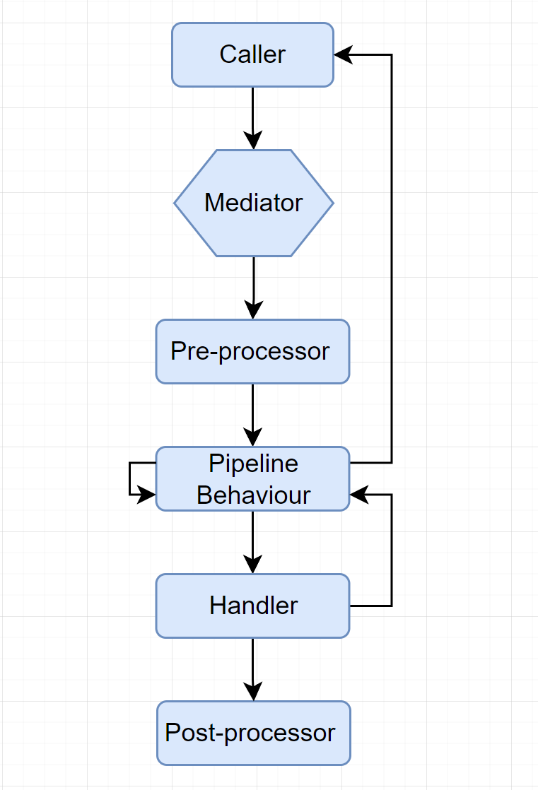

Slide 11
Q&A

